Slide 1
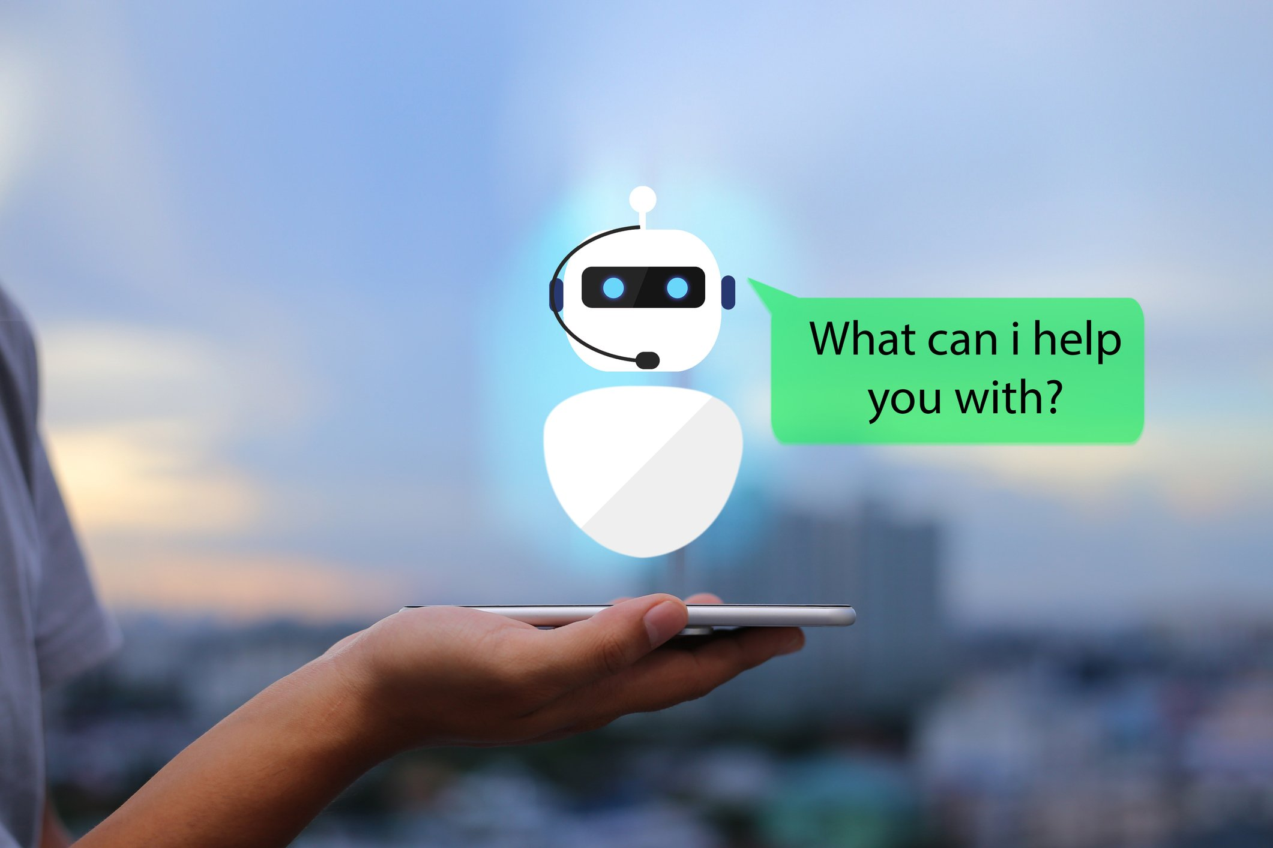
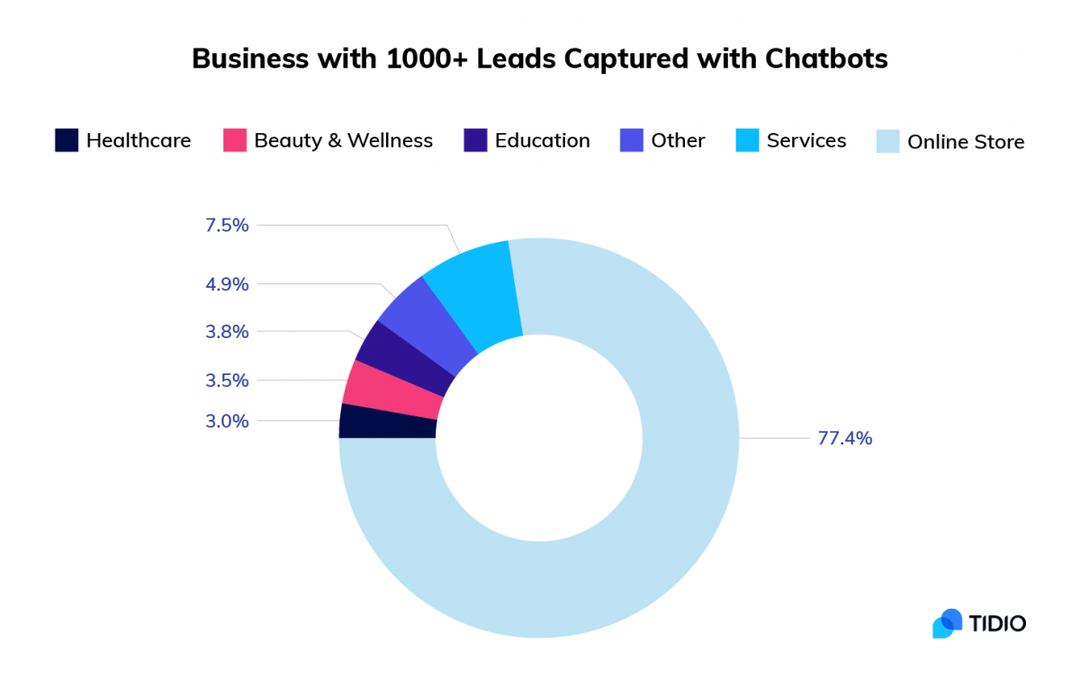
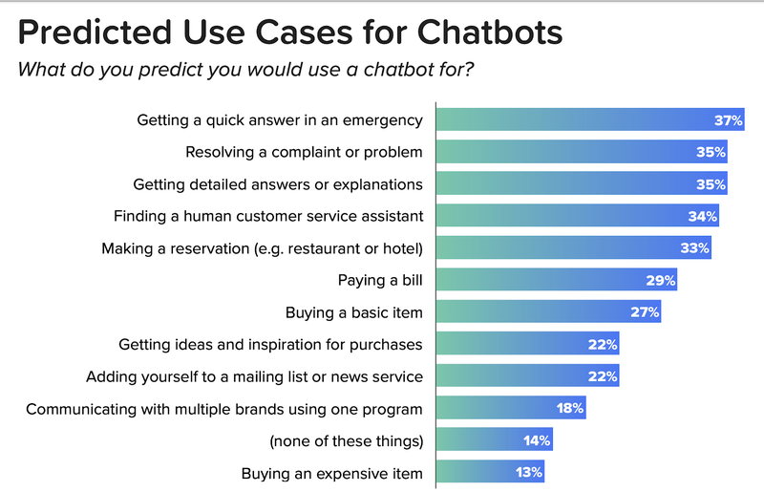
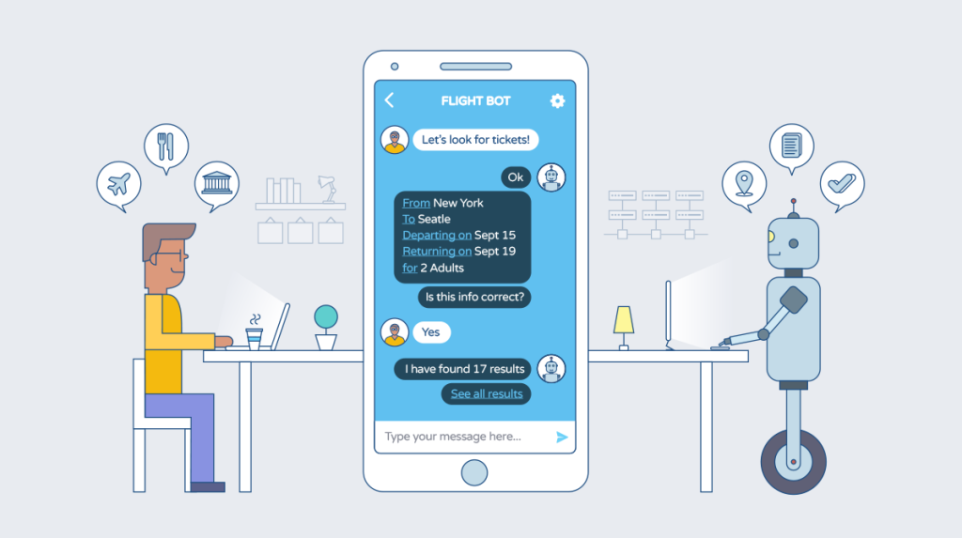
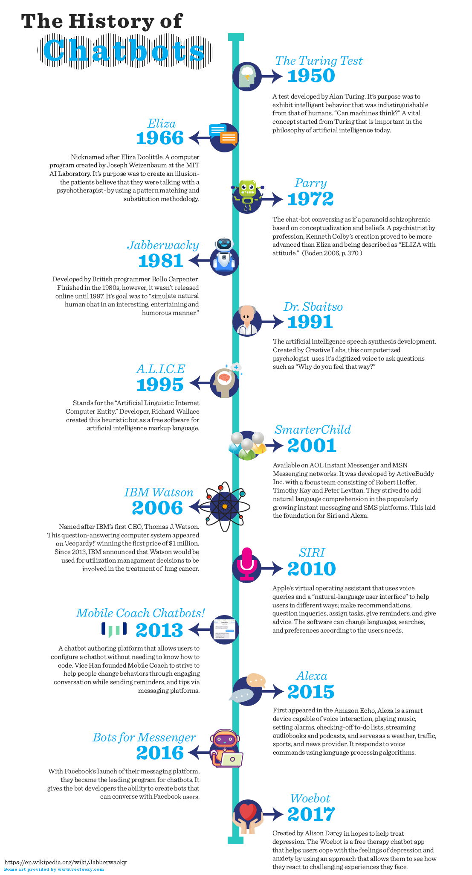
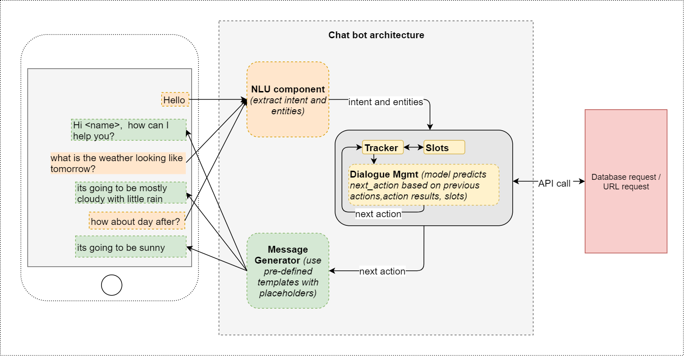
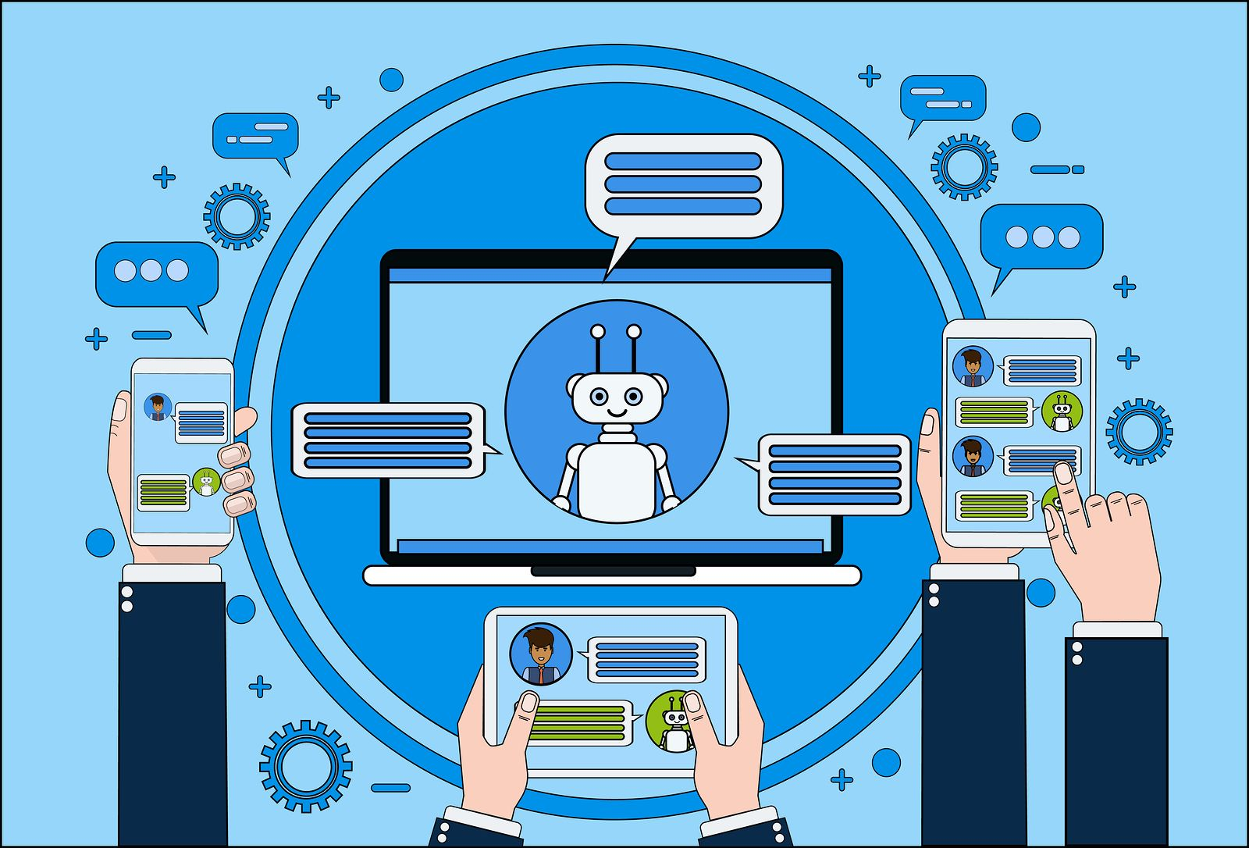
CHATBOT
INTRODUCTION
*A Chatbot is a computer program that can understand human language and converse with a user via a website or a messaging app.
*chatbots can handle various tasks online from answering simple questions and scheduling calls to gathering customer feedback.
*brands use bots to automate their business processes , speed up customer service , and lower support costs.
CHATBOT STATISTICS
H0W DOES CHATBOT WORKS
*A chatbot performs routine automated tasks based on specific triggers and algorithms , simulating human conversation.
*A bot is designed to interact with a human via a chat interface or voice messaging in a web or mobile application , the same way a user would communicate
with another person.
*For example , if a user asks about tomorrow’s weather , a traditional chatbot can respond plainly whether it will rain. An AI chatbot , however , might also inquire if the user wants to set an earlier alarm to adjust for the longer morning commute(due to rain)
LITERATURE SURVEY
*A chatbot allows a user to simply ask questions in the same manner that they would address .
*The most well known voice bots are:Alexa and siri.
*however chatbots are currently being adopted at a high rate on computer chat platforms.
TITLE | AUTHOR | PUBLICA-TION YEAR | FINDINGS
Chatbot’s meet eHealth: | Flora amato, Stefano marrone, Vincenzo Moscato and Carlo sansone | 2017 | The recent advances of technologies for data processing and analytics have radically changed giving the rise to digital healthcare solutions.
Textbased heathcare chatbots supporting patient and health professional teams | University of st.gallen institute of technolog | 2018 | It have the potential to support patients in their everyday life And health professionals likewise.
PROBLEM IDENTIFICATION
*All the companies wants their clients to know about them and they can get more projects or sell their product . so the most primary way to do this is to have a good interactive website in the advanced world of digital marketing.
*But in this advanced world just having a website is not enough because all the queries cannot be solved.
*So , For that you need a chatbot not an ordinary one “An Intelligent chatbot” with Artificial Intelligence technology.
CONCLUSION
*Extensions and perquisite enabled relations between responses that significantly make it easier for user to chat with chatbot using the same approach as chatting with an actual human.
*Chatbot can give different responses from the same input given by user according to current conversation issue.
*A chatbot is one of the simple ways to transport data from a computer without having to think for proper keywords to look up in search or browser several web pages to collect information.

